Slide 1



Network Intrusion Detection Using Artificial Neural Networks
This project focuses on developing a network intrusion detection system using artificial neural networks. The system is trained on the KDD Cup 1999 dataset, a subset of the original data, with the goal of improving accuracy and time-efficiency compared to traditional rule-based methods.

Slide 2

Exploratory Data Analysis
1
494,021 Rows
2
42 Columns
3
23 Output Classes
The KDD Cup 1999 dataset contains 494,021 rows of network connection data.
Out of the 42 columns, 41 represent various features of network connections, and the last column indicates whether the connection is normal or an intrusion.
There are 23 output possibilities, with one representing a normal connection and the remaining 22 representing different types of intrusions.

Slide 3
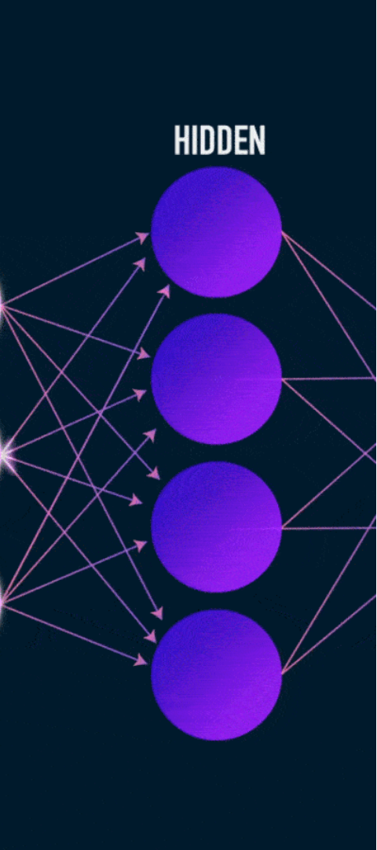
Methodology
1
Data Preprocessing
Encoding non-numerical features, applying PCA for dimensionality reduction, and normalizing input features.
2
Neural Network Architecture
Five-layer architecture with one input, one output, and three hidden layers using ReLU and Sigmoid activations.
3
Hyperparameter Tuning
Experimenting with training/test split ratios, batch sizes, PCA components, and early stopping to optimize performance.

Slide 4
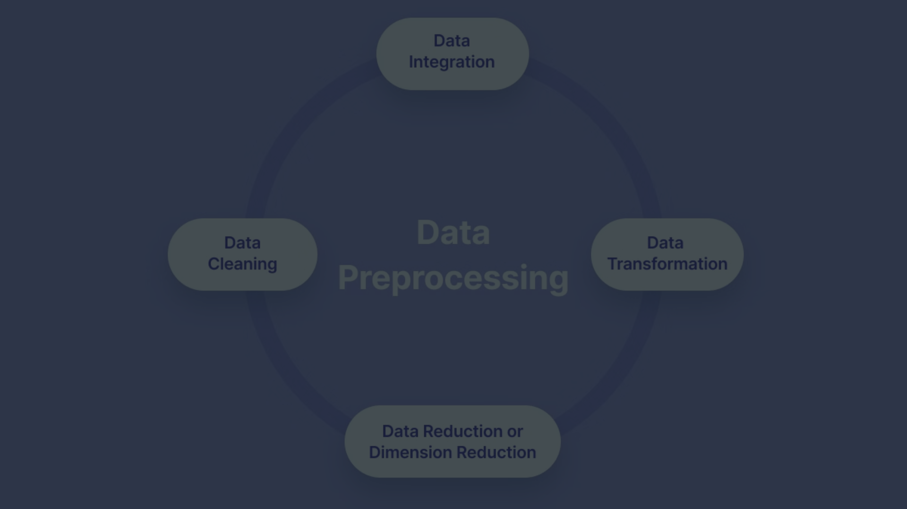
Data Preprocessing
Feature Encoding
Dimensionality Reduction
Normalization
Non-numerical feature values and output possibilities were encoded with numerical values.
Principal Component Analysis (PCA) was applied to reduce the dimensionality of the data while preserving most of the relevant information.
MinMax scaling was used to normalize the input features, further improving the model's accuracy.

Slide 5
Neural Network Architecture
Input Layer
Hidden Layers
Output Layer
The input layer receives the preprocessed network connection data.
The output layer uses Sigmoid activation to predict whether the connection is normal or an intrusion.
Three hidden layers with ReLU activation function to capture complex patterns in the data.

Slide 6
Hyperparameter Tuning and Optimization
1
Training/Test Split
The 0.65/0.35 split ratio yielded the highest test accuracy of 0.9937.
2
Batch Size
A batch size of 128 provided the best balance between training time and accuracy.
3
PCA Components
32 PCA components achieved the optimal test accuracy of 0.9991.

